Slide 1
Data Structure and Algorithm
Heap
11/05/08
Data Structure and Algorithm

Slide 2
Heap
A heap is a complete binary tree except the bottom level adjusted to the left.
The value of each node is greater than that of its two children. (Max Heap)
The value of each node is less than that of its two children. (Min Heap)
Height of the heap is log₂n.
Example
100
100
21
16
21
17
14
19
17
14
19
16
Figure: Not a Heap
Figure: A Heap
11/05/08
Data Structure and Algorithm

Slide 3
Heap Implementation
We can use an array (due to the regular structure or completeness of binary tree).
For a node N with location i, the following factors can be calculated.
1. Left child of N is in location (2 * i).
2. Right child of N is in location (2 * i + 1).
3. Parent of N is in location [i/2].
Example
100
1 2 3 4 5 6 7 8 9
100
21
17
14
19
16
21
17
14
19
16
Figure: Heap and Its Array Representation
11/05/08
Data Structure and Algorithm

Slide 4
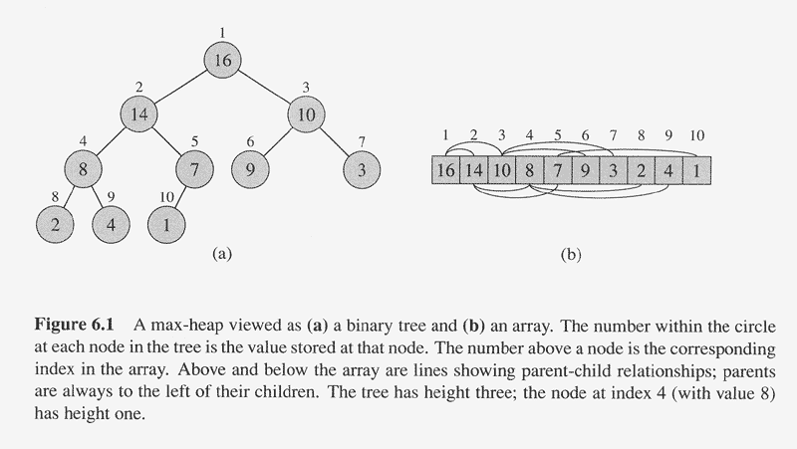
Copyright © The McGraw-Hill Companies, Inc. Permission required for reproduction or display.
11/05/08
Data Structure and Algorithm

Slide 5
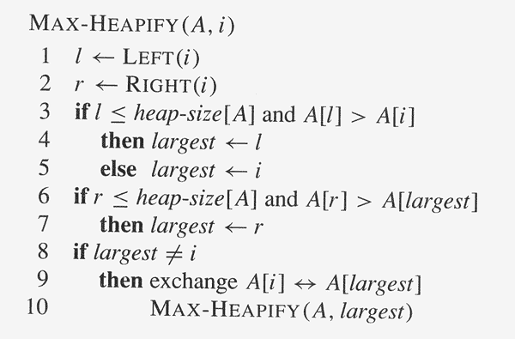
Copyright © The McGraw-Hill Companies, Inc. Permission required for reproduction or display.
11/05/08
Data Structure and Algorithm

Slide 6
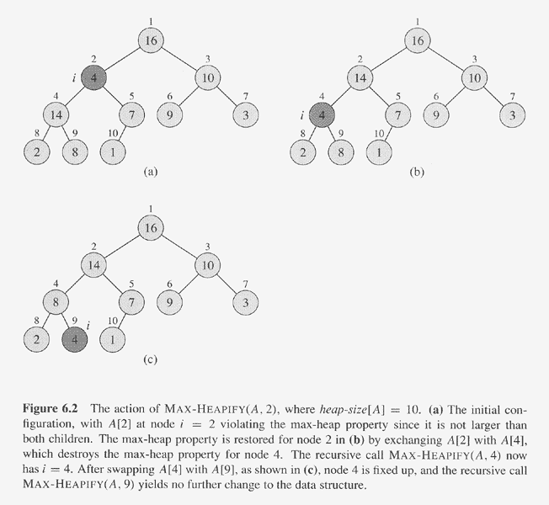
Copyright © The McGraw-Hill Companies, Inc. Permission required for reproduction or display.
11/05/08
Data Structure and Algorithm

Slide 7
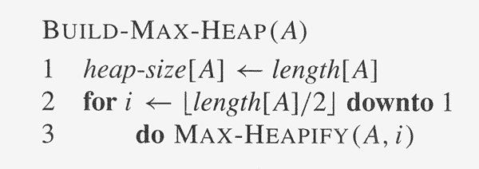
Copyright © The McGraw-Hill Companies, Inc. Permission required for reproduction or display.
11/05/08
Data Structure and Algorithm

Slide 8
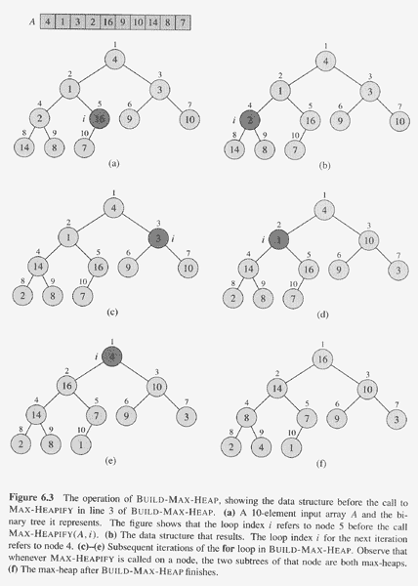
Copyright © The McGraw-Hill Companies, Inc. Permission required for reproduction or display.
11/05/08
Data Structure and Algorithm

Slide 9
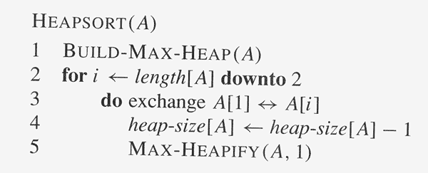
Copyright © The McGraw-Hill Companies, Inc. Permission required for reproduction or display.
11/05/08
Data Structure and Algorithm

Slide 10
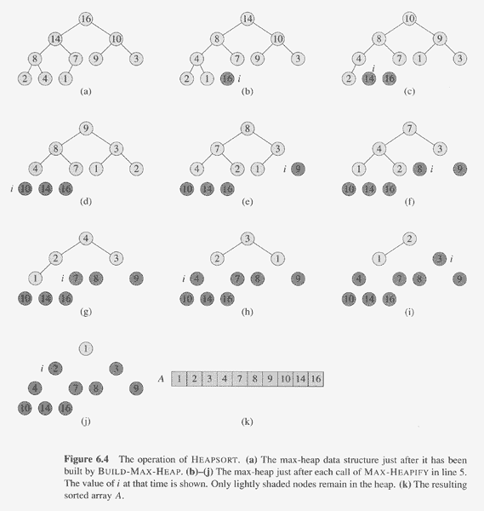
Copyright © The McGraw-Hill Companies, Inc. Permission required for reproduction or display.
11/05/08
Data Structure and Algorithm

Slide 11
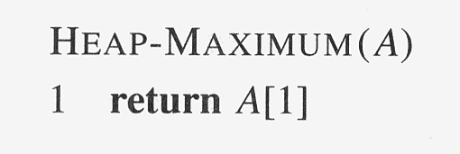
Copyright © The McGraw-Hill Companies, Inc. Permission required for reproduction or display.
11/05/08
Data Structure and Algorithm

Slide 12
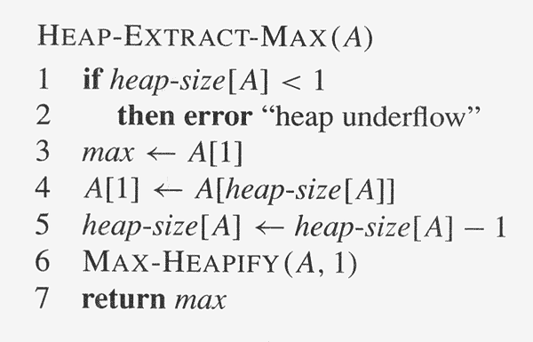
Copyright © The McGraw-Hill Companies, Inc. Permission required for reproduction or display.
11/05/08
Data Structure and Algorithm

Slide 13
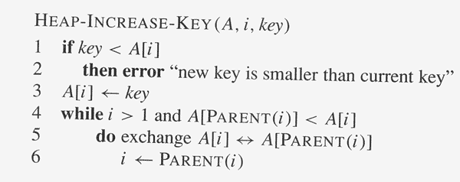
Copyright © The McGraw-Hill Companies, Inc. Permission required for reproduction or display.
11/05/08
Data Structure and Algorithm

Slide 14
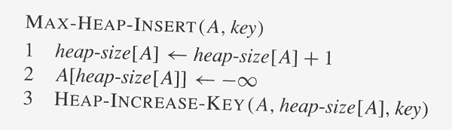
Copyright © The McGraw-Hill Companies, Inc. Permission required for reproduction or display.
11/05/08
Data Structure and Algorithm

Slide 15
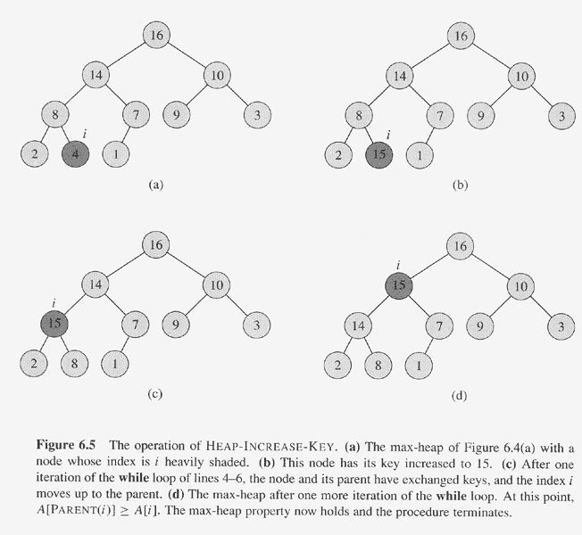
Copyright © The McGraw-Hill Companies, Inc. Permission required for reproduction or display.
11/05/08
Data Structure and Algorithm

Slide 16
Copyright © The McGraw-Hill Companies, Inc. Permission required for reproduction or display.
11/05/08
Data Structure and Algorithm

